Slide 1
Agentic AI Hackathon: Building Intelligent Agents with IBM Granite and LangFlow
AI-Based Preventive Health Risk Assessment System

Slide 2



Name of the team: SKYMINDS
Details of Team members
TEAM MEMBER NAME | Recent Passport Photo | Email ID | Phone number [WhatsApp]
Piyush Kumar |  | piyush407kumar@gmail.com | +91 88823 05045
Rishon Barnes |  | barnesrishon22@gmail.com | +91 80880 05192
Shreya Karn |  | k.ayerhs0@gmail.com | +91 9204087976

Slide 3
Problem statement
Preventive Health Risk
The Challenge
Preventive health risk management can be overwhelming, as individuals often struggle with:
Information overload – navigating countless articles, apps, and medical sites with conflicting health advice.
Personalization gaps – generic recommendations that don’t account for age, lifestyle, medical history, or genetic risk factors.
Unreliable sources – misinformation, unverified claims, and inconsistent guidance across platforms.
Lack of early awareness – symptoms and risk indicators often go unnoticed until conditions become serious.
Dynamic health factors – changing stress levels, habits, environment, and routines that continuously impact health risk.
Without a reliable, intelligent preventive health assistant, individuals spend excessive time researching, delay proactive care, and miss early intervention opportunities—leading to avoidable illnesses, higher healthcare costs, and reduced quality of life.

Slide 4
Proposed solution
The proposed solution is an AI-based preventive health risk management system designed to help individuals identify, understand, and reduce potential health risks at an early stage. The system analyzes user-specific data such as age, lifestyle habits, medical history, and daily activities to generate personalized health risk assessments.
Using machine learning algorithms, the system predicts the likelihood of chronic and lifestyle-related diseases such as diabetes, cardiovascular issues, obesity, mental health issue and stress-related disorders. Based on these predictions, it provides customized preventive recommendations.
The solution integrates trusted medical guidelines and verified health data sources to ensure accuracy and reliability, reducing the risk of misinformation. A conversational AI interface allows users to interact naturally with the system, ask health-related questions, and receive clear, easy-to-understand explanations.
By continuously monitoring changes in user behavior and health indicators, the system dynamically updates risk levels and recommendations, enabling early detection, proactive care, and better long-term health outcomes.

Slide 5
Need of project
In today’s fast-paced lifestyle, health issues are often detected only after they become severe, leading to higher medical costs and reduced quality of life. People lack awareness, timely guidance, and personalized preventive care, relying mostly on generic health information from unreliable sources.
There is a strong need for an intelligent system that can analyze individual health data, identify potential risks early, and provide personalized preventive recommendations. An AI-based preventive health risk system helps bridge the gap between reactive healthcare and proactive health management by enabling early detection, continuous monitoring, and informed decision-making.
This project is needed to promote preventive healthcare, reduce the burden on medical systems, minimize avoidable diseases, and empower individuals to take control of their health using reliable, data-driven insights.

Slide 6
End user of project
The end users of the AI-based Preventive Health Risk project include:
General Public / Individuals
People who want to monitor their health proactively, identify potential health risks early, and receive personalized preventive health recommendations.
Working Professionals
Individuals with busy lifestyles who are prone to stress, poor diet, and sedentary habits, and need intelligent health guidance to prevent lifestyle-related diseases.
Elderly People
Users who require continuous health risk monitoring, early warnings, and preventive care suggestions to manage age-related health conditions.
Patients with High-Risk Conditions
Individuals with family history or early signs of chronic diseases such as diabetes, hypertension, or heart disease.
Healthcare Providers (Optional/Secondary Users)
Doctors, clinics, or wellness centers who can use the system insights to support preventive care and patient health monitoring.
Health & Wellness Organizations
Organizations promoting preventive healthcare, wellness programs, and public health initiatives.

Slide 7
Technology Used
Langflow platform
Langflow component name – Agent , Chat input, Parser, Astra DB, Duck Duck Go, Chat output
IBM Grainte model - ibm-granite-3-8b
IBM Cloud
IBM Watsonx.ai
Watson Service

Slide 8
Novelty and Uniqueness
Build an intelligent system that predicts potential health risks early, based on lifestyle, medical history, wearable sensor data, and environmental factors.
Provide personalized preventive recommendations to reduce risk and improve long-term health outcomes.

Slide 9
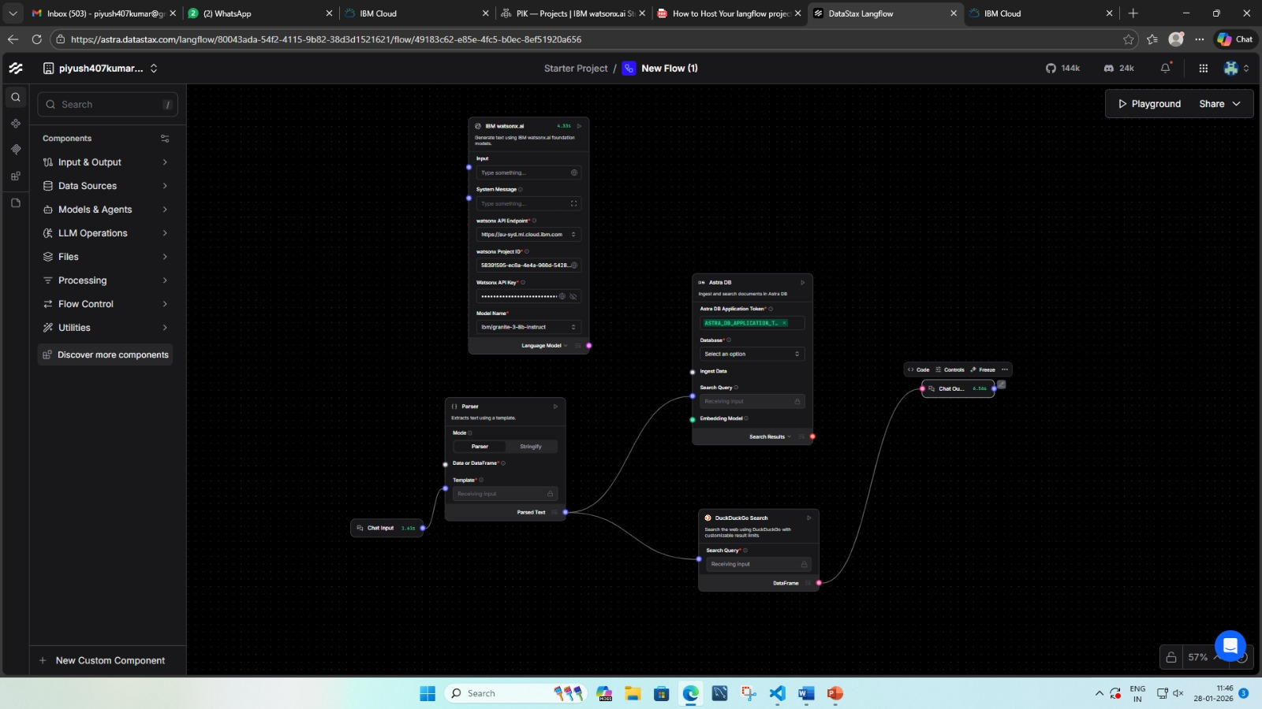
Technical flow diagram - Architecture blueprint

Slide 10
Langflow component Used
Explain the use of each langflow component used into you project
Chat input
Parser
Astra DB
Agent
Duck Duck Go
Chat output

Slide 11
Input Screenshot 1

Slide 12
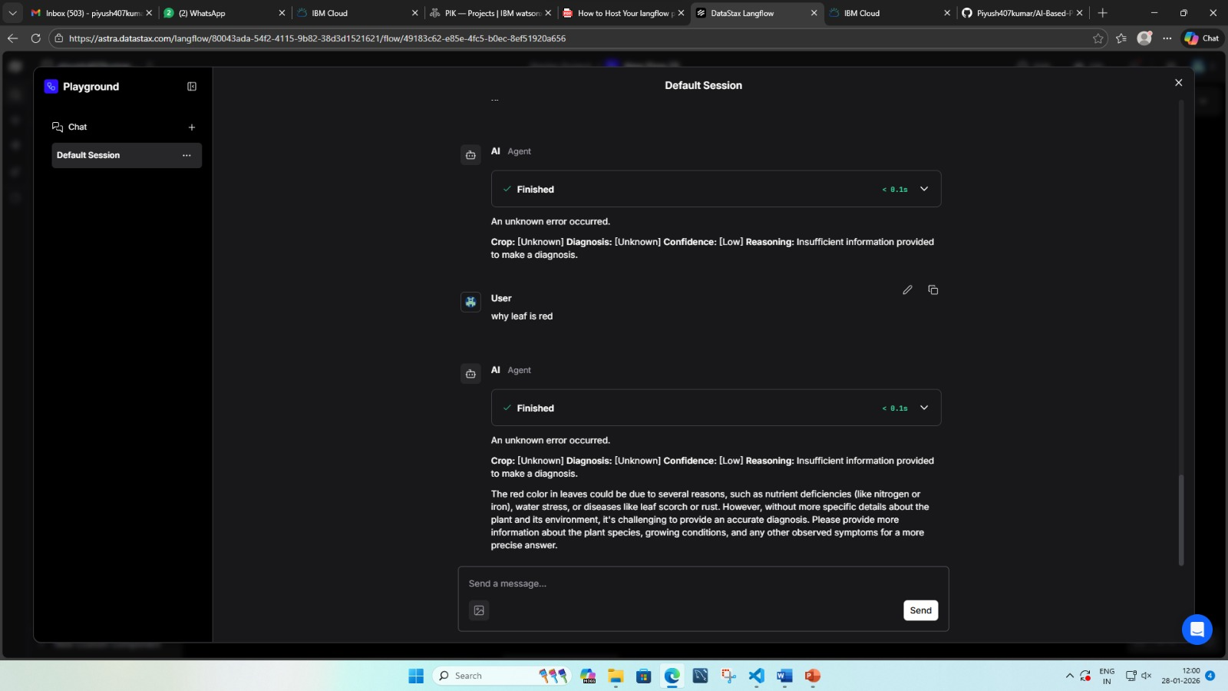
Output Screenshot 1

Slide 13
Future Scope
Integration with wearable and IoT health devices for real-time monitoring
Use of advanced AI/ML models for more accurate risk prediction
Multilingual and voice-enabled conversational AI support
Secure integration with hospitals and healthcare providers
Large-scale population health analysis using cloud technology

Slide 14
Git Hub Link
· https://github.com/Piyush407kumar/AI-Based-Preventive-Health-Risk-Assessment-System.git

Slide 15
References
Optum. (2023). Transforming healthcare with data, analytics, and AI. Retrieved from https://www.optum.com

Slide 16


